Slide 1
Memento Design Pattern
Marina Nady Youssef

Slide 2
Memento Design Pattern
Memento pattern is used to restore the state of an object to a previous state.
Memento pattern falls under the behavioral pattern category.

Slide 3
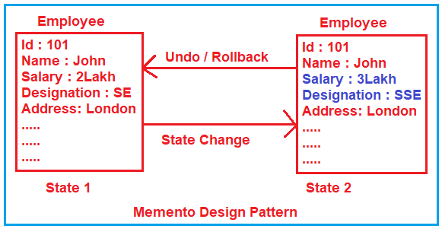
Memento Design Pattern

Slide 4
Forces
Application needs to capture states at certain times or at user discretion. May be used for:
Undo / redo
Log errors or events
Backtracking
Need to preserve encapsulation
Don’t share knowledge of state with other objects
Object owning state may not know when to take state snapshot.

Slide 5
Implementation
Memento pattern uses three actor classes.
Memento contains state of an object to be restored.
Originator creates and stores states in Memento objects and
Caretaker object is responsible to restore object state from Memento.

Slide 6
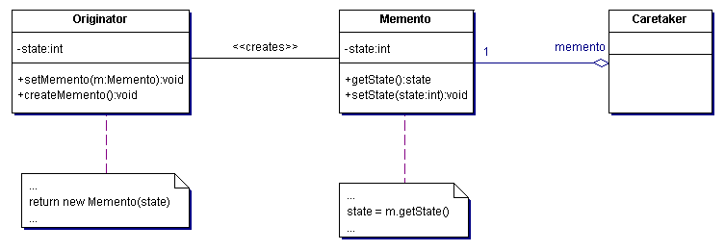
Memento Pattern - Structure
Intent
Without violating encapsulation, capture and externalize an object's internal state so that the object can be returned to this state later.
Structure

Slide 7
Participants
Memento
Stores internal state of the Originator object. Originator decides how much.
Protects against access by objects other than the originator.
Mementos have two interfaces:
Caretaker sees a narrow interface.
Originator sees a wide interface.

Slide 8
Participants (continued)
Originator
Creates a memento containing a snapshot of its current internal state.
Uses the memento to restore its internal state.

Slide 9
Caretaker
Is responsible for the memento’s safekeeping.
Never operates on or examines the contents of a memento.

Slide 10
Demo

